Slide 1
WP#9 Practical Results

Slide 2
Stochastic Parametrization
Stochastic function parametrization for inter-arrival time
many “vague” suggestions of procedures
many theoretical works about classes of functions (not parametrization)
heavy-tailed functions
self-similar functions
But, a clear and unified procedure is missing for parametrization
Black-box

Slide 3
Stochastic Parametrization
It just consolidate some ideas
Linearization / Linear Regression
Data Collection
Maximum likelihood
Parametrization
Likelihood evaluation (BIC-AIC)
Model selection
Other estimator

Slide 4
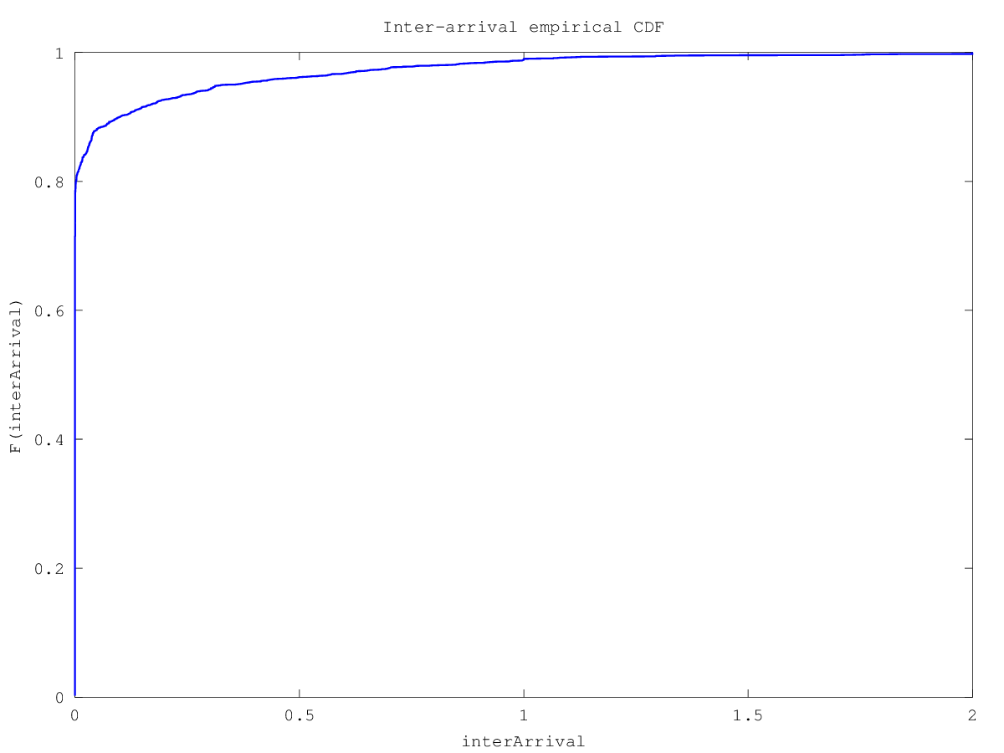
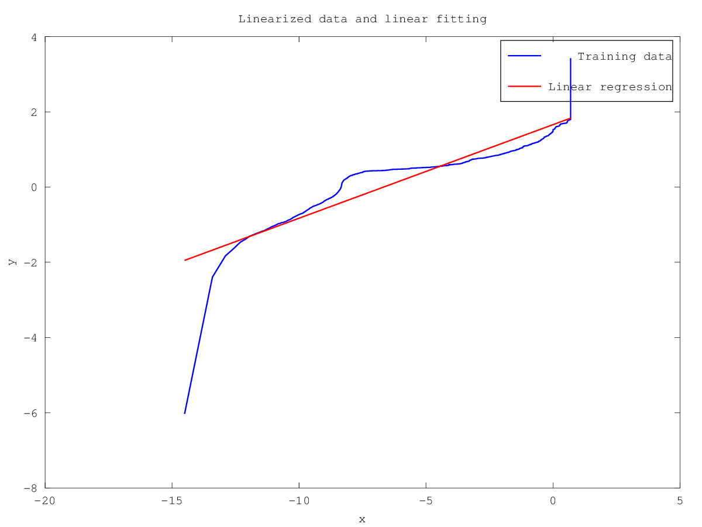
Stochastic Parametrization
*Qualification trace
Other methods: Direct estimation, maximum likelihood

Slide 5
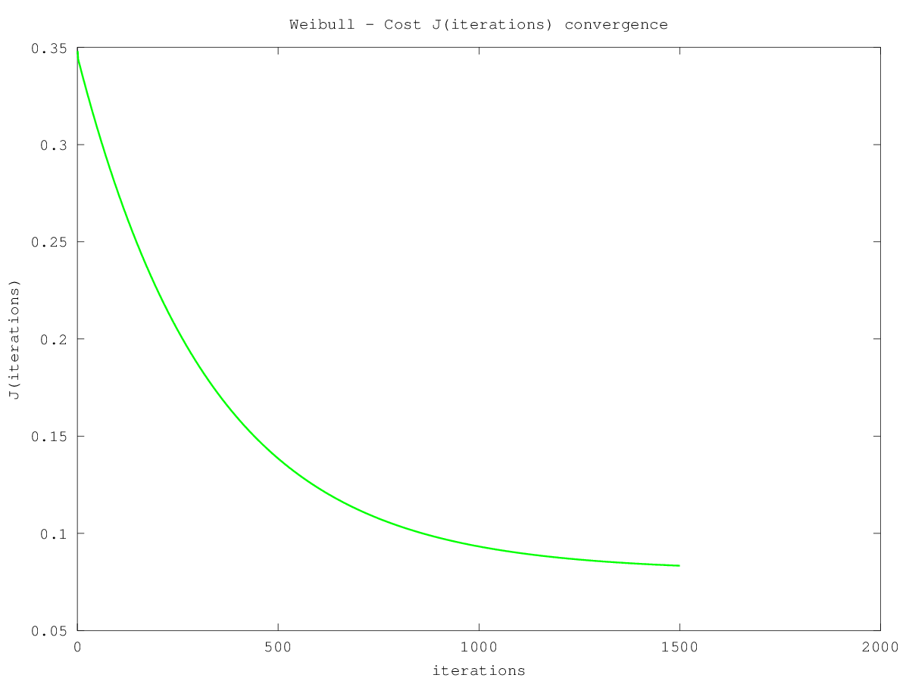
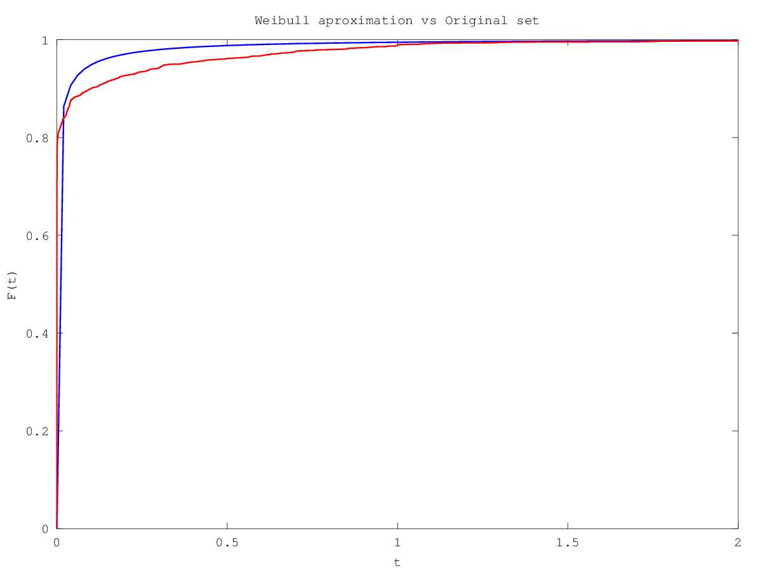
Stochastic Parametrization

Slide 6
Likelihood evaluation
+----------------+--------------+---------------+
|Function |AIC |BIC |
+----------------+--------------+---------------+
|Pareto(MLH) |-34471.116188 |-34459.163684 |
|Pareto(LR) |-34233.903417 |-34221.950913 |
|Weibull |-33724.656739 |-33712.704235 |
|Cauchy |-27133.337028 |-27121.384524 |
|Exponential(Me) |-11084.298901 |-11078.322649 |
|Exponential(LR) |-3455.031125 |-3449.054873 |
|Normal |-945.263174 |-933.310670 |
+----------------+--------------+---------------+

Slide 7
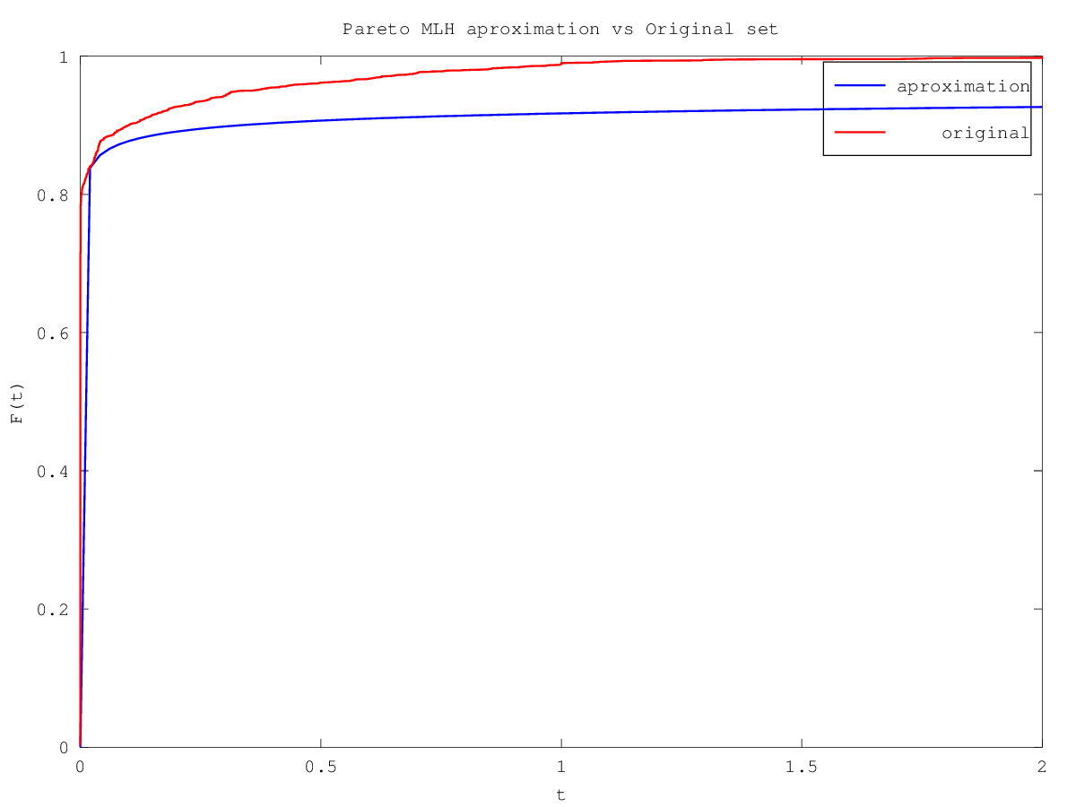
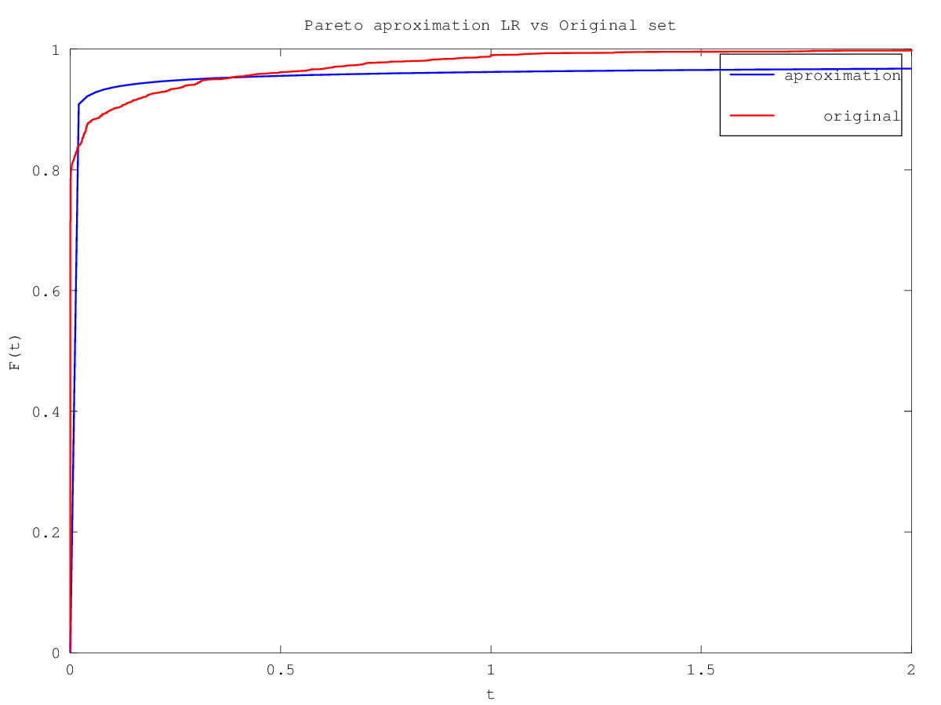
Pareto(MLH), Pareto(LR)

Slide 8
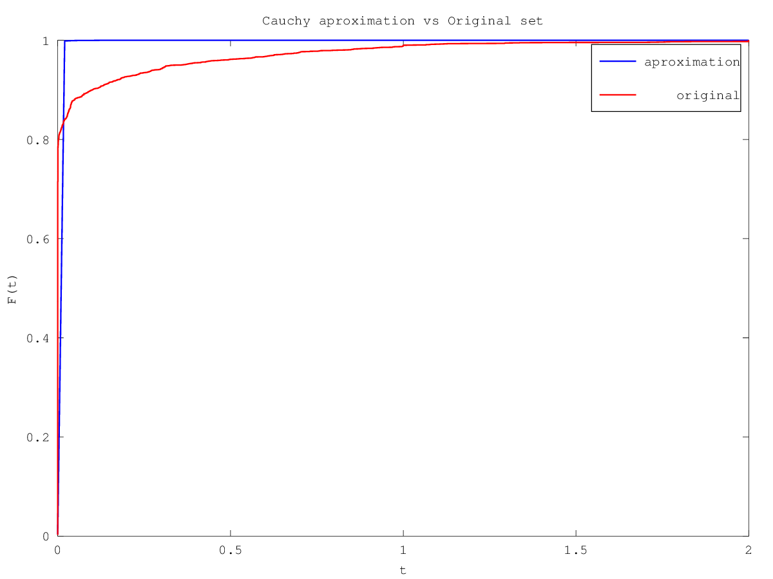
Weibull, Cauchy

Slide 9
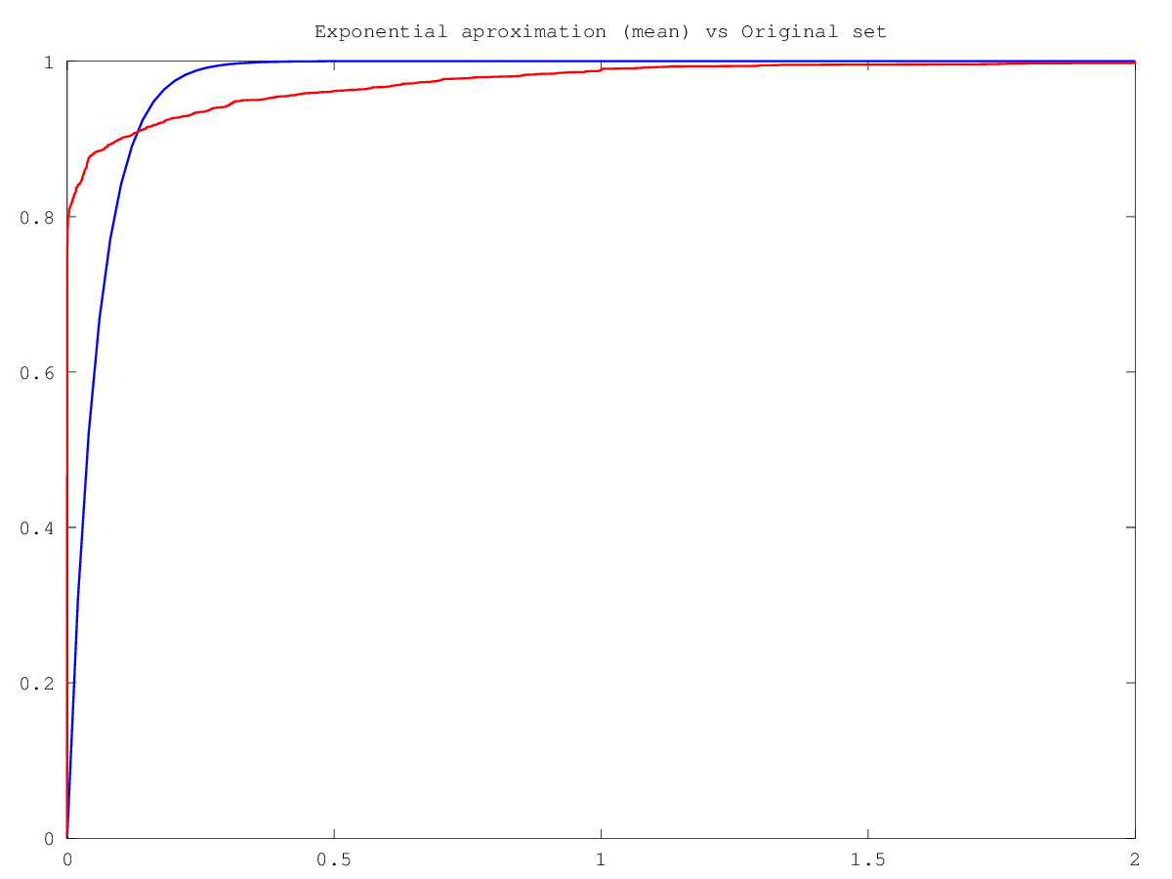
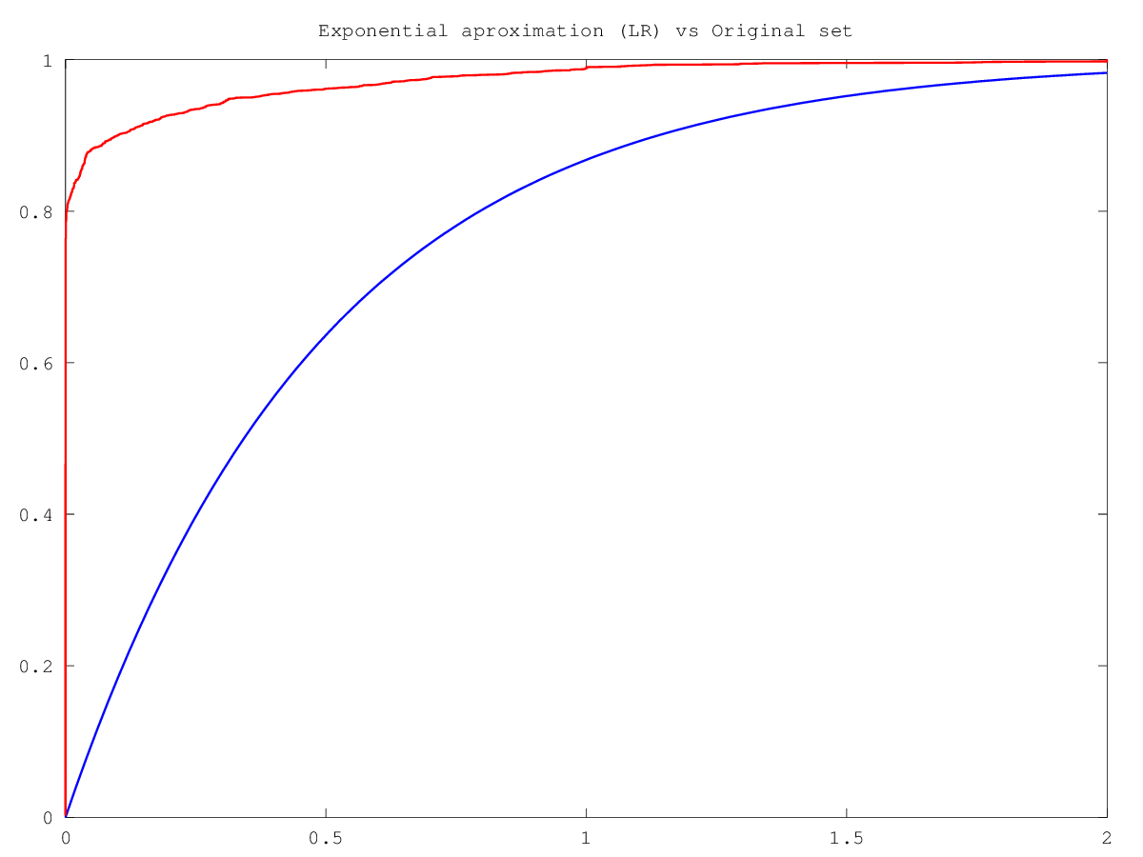
Exponential(Me), Exponential(LR)

Slide 10
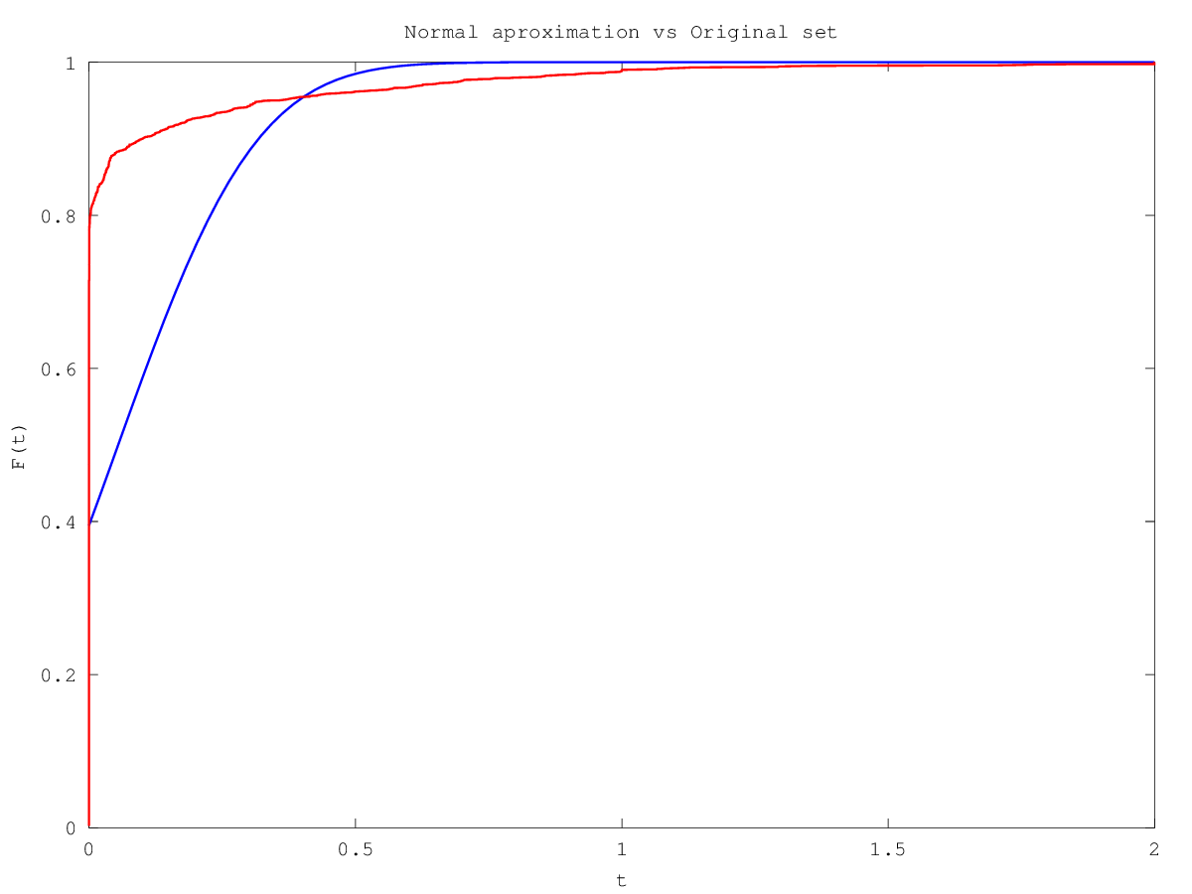
Normal

Slide 11
Observations
Execution time (for the used dataset)
Matlab: ~7 minutes
C++: < 3 seconds (huge speed up, enable real-time)
Algorithms are already integrated to the main project
In the main project, this procedure is applied for each flow

